Slide 1
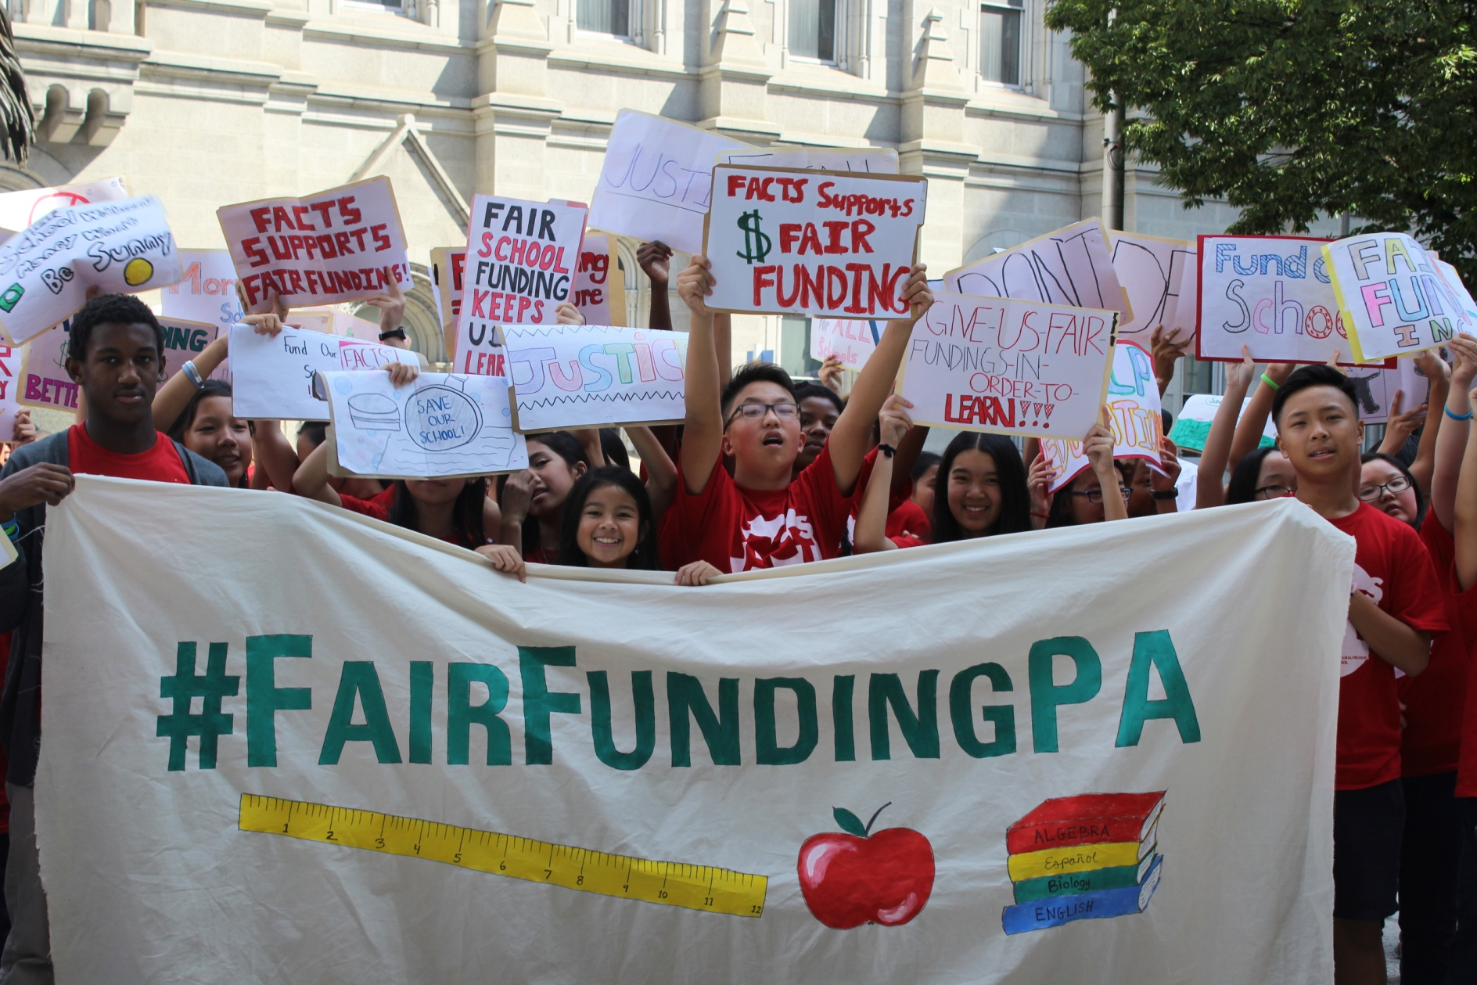
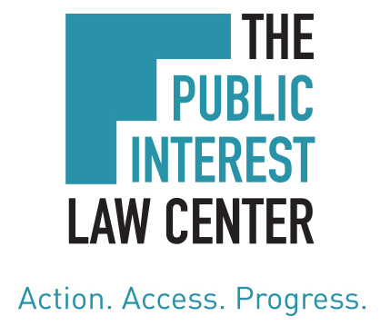
Education Funding in Pennsylvania: Inadequate, Inequitable & Unconstitutional

Slide 2
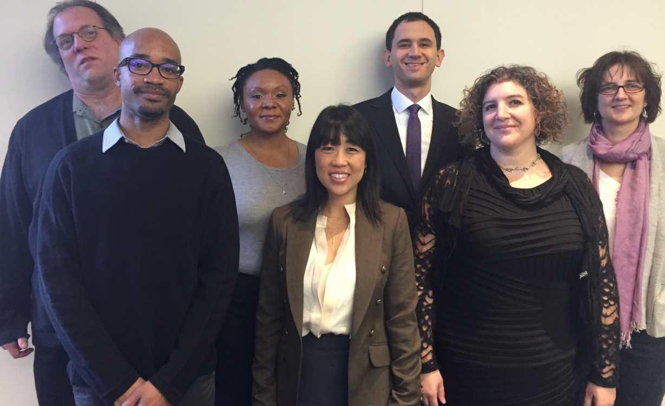
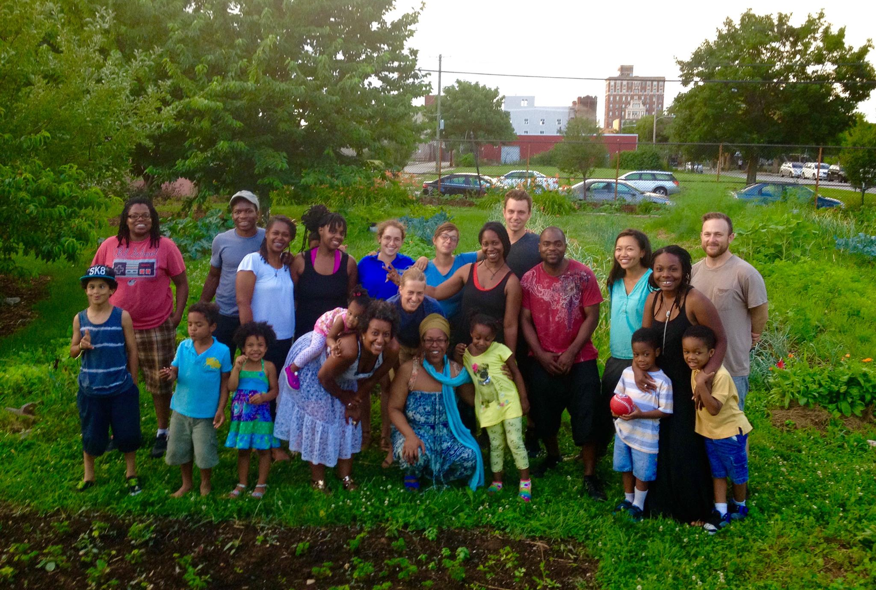
About the Public Interest Law Center

Slide 3
The Long Term Problem
Pennsylvania School Funding:
Low relative state contribution
Most funding not based on formula
No goal of fully funding schools
Unfair property tax burdens
Unacceptable outcomes for children

Slide 4
Sources of Pennsylvania Education Funds

Slide 5
How does Pennsylvania compare?

Slide 6
Ratio of State and Local Money Spent on Rich Districts vs. Poor Districts

Slide 7
Tax Disparity in Delaware County
District | Tax burden: Equalized Mills | Revenue per Student
Marple Newtown SD | 12.6 | $21,994.58
Radnor Township SD | 13.8 | $23,134.07
Rose Tree Media SD | 16.6 | $22,070.70
Chester-Upland SD | 18.8 | $17,593.46
Haverford Township SD | 19.0 | $17,605.61
Penn-Delco SD | 19.7 | $15,306.84
Springfield SD | 20.8 | $16,960.64
Garnet Valley SD | 21.3 | $18,864.08
Interboro SD | 24.3 | $17,411.21
Upper Darby SD | 25.5 | $13,767.43
Wallingford-Swarthmore SD | 27.1 | $19,667.04
Southeast Delco SD | 28.7 | $15,296.67
Ridley SD | 28.9 | $17,468.90
Chichester SD | 30.4 | $19,398.06
William Penn SD | 32.8 | $15,633.13

Slide 8
Local Effort is Not the Problem:
Radnor vs. William Penn
Radnor S.D.
Tax rate: 13.8 mil
Local tax revenue per child: $19,675
State per student contribution: $3,279
State/local per student: $22,954
Students in poverty: 8.2%
William Penn S.D.
Tax rate: 32.8 mil
Local tax revenue per child: $8,231
State per student contribution: $6,809
State/local per student: $15,039
Students in poverty: 47.9%
Difference = $7,915

Slide 9
Local Effort is Not the Problem:
Tredyffrin vs. Reading
Tredyffrin S.D.
Tax rate: 11.9 mil
Local tax revenue per child: $14,861
State per student contribution: $2,725
Total per student: $17,586
Reading S.D.
Tax rate: 23.3 mil
Local tax revenue per child: $2,267
State per student contribution: $8,955
Total per student: $11,222
Difference = $6,364

Slide 10
Which District Needs More? More ?
Tredyffrin SD
7.9% Students in Poverty
1.5% English Language Learners
Reading SD
81.8% Students in Poverty
19.6% English Language Learners

Slide 11
How did we get here?
From 1991-2015, with the exception of three years, funds allocated with virtually no provision for growth, and with no provision for total need.
Politically powerful districts could get special line items to increase funds to their districts, creating piecemeal system.

Slide 12
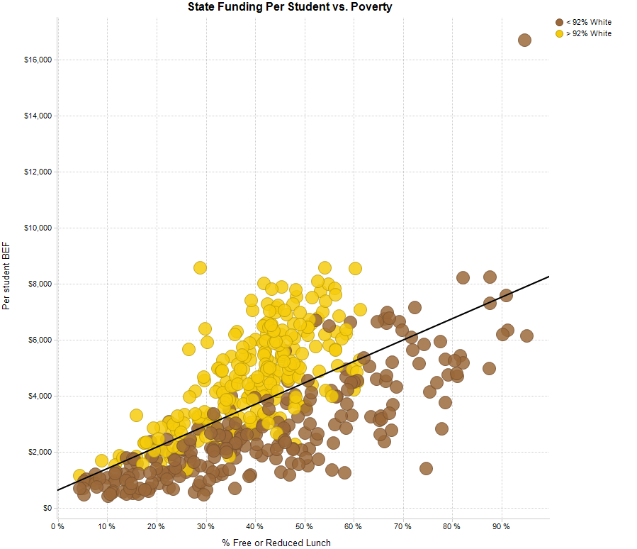
Uncomfortable Realities
Source: David Mosenkis, POWER

Slide 13
The Accident of Birth: Lower Merion and Philadelphia Revenues Per Student (2015 $)

Slide 14
The Recent History
The costing out study, a movement towards adequacy, and retrenchment

Slide 15
The movement towards adequacy
2007 study commissioned by the Legislature found $4.4 billion was needed to meet state proficiency standards.
Gov. Rendell sets target of $2.4 billion and begins regular increases.
Governor Corbett takes office and cuts $851 million dollars of education funding.

Slide 16
2011 Cuts Hit Poorer Districts Hardest
$ Cut per Student | N | Students in Poverty %Poverty
Over $700 | 29 districts | 58.97%
$500 to $700 | 130 districts | 46.99%
$300 to $500 | 187 districts | 34.87%
$150 to $300 | 103 districts | 22.82%
Under $150 | 51 districts | 11.78%
Note: Cuts include reductions in Basic Education, Accountability Block Grants, Reimbursement for Charter Schools, and Education Assistance Program from 2010-11.

Slide 17
Effects of Massive State Cuts
50% of districts raise elementary class sizes
27,000 positions cut statewide
416 school districts raise property taxes post 2011-15, at median of 6.6% increase
$570 million remain in cuts remain as Corbett leaves office

Slide 18
Philadelphia’s Burden of 2011 Cuts
$153 million

Slide 19
Philadelphia Dramatically Increases Local Funding

Slide 20
Effects of Massive State Cuts in Philadelphia
$300 Million in state/federal funds cut in single year
Class sizes increase to average of 32 (with exception of special education classrooms)
23 schools closed in 2013
162 Schools without a full time nurse in 2015-16
80% reduction in capital spending, 20% percent reduction in operations and maintenance of physical plant

Slide 21
Governor Wolf’s Initial Proposal
$2 billion in Pre-K - 12 education over 4 years
$2 billion included $500+ million for 2015-2016, with money targeted first to districts who were cut
After protracted budget struggle: $350 million total over two years for basic education funding, not targeted first to districts which where cut

Slide 22
Basic Education Funding Commission Formula (Enacted July 2016)
Strengths:
Uses 3 year average student count.
Adds weights for poverty, concentrated poverty, English
Language learners, district sparsity, charter students.
Takes account of district tax effort and fiscal capacity to raise local share, replacing the traditional aid ratio.

Slide 23
Basic Education Funding Commission Formula (Enacted July 2016)
Weaknesses:
Purposefully excludes total funding needed, so only looks at relative needs of districts
Only applies to funding added after its adoption, so inequities are locked in
$1.1 billion worth of inequity baked in
No Impact on Unequal Local Tax Burdens

Slide 24
Funding Formula Demonstrates the Unfairness of the Current System
Rank | School District | Gain if all funds were distributed according to the formula | Change Per Student
1 | York City SD | $50,968,403 | $6,588
2 | Reading SD | $97,998,567 | $5,415
3 | Pottstown SD | $13,772,505 | $4,218
4 | Harrisburg City SD | $29,048,235 | $4,113
5 | Lancaster SD | $43,751,120 | $3,827
6 | Wilkes-Barre Area SD | $25,877,225 | $3,461
7 | Hanover Public SD | $5,840,933 | $3,117
8 | Allentown City SD | $57,381,721 | $3,042
9 | Sto-Rox SD | $5,211,615 | $2,996
10 | Jim Thorpe Area SD | $6,698,091 | $2,996
11 | Lebanon SD | $13,697,719 | $2,759
12 | Scranton SD | $27,303,244 | $2,742
13 | Midland Borough SD | $1,058,464 | $2,438
31 | Philadelphia SD | $298,419,264 | $1,470

Slide 25
Funding Formula Demonstrates Racial Inequities in Current Funding
Source: David Mosenkis,
POWER

Slide 26
How much do school districts need today?
Despite the state not wanting to publish an “adequacy” amount, the Law Center conducted a study which used the new funding formula to give estimates of the amount the state needs to contribute.
State funds needed:
Between $3 and $4 billion
Study available: www.pubintlaw.org/befc-adequacy-calculation/

Slide 27
$3-4 Billion would be impossible to raise…
Source: Ron Cowell, Education and Policy Leadership Center

Slide 28
Does the Funding Formula Make the System Fair? No.

Slide 29
Why does this matter?
Statewide PSSA results show our children are struggling:
Math (grades 3-8): 57.5% score below proficient, and more than 25% score below basic.
English Language Arts (grades 3-8): 39.5% score below proficient,
Science (grades 4 and 8): 33% below proficient
Statewide Keystone results show the same for high school students:
31.8% below proficient in Algebra, 23.2% below proficient in Literature, and 34.2% below proficient in Biology.

Slide 30
Why should we care? (Besides the obvious.)
Achievement Opportunity gaps for children of color and disadvantaged kids costs all of us.
2015 Rand Corporation Study finds:
Since 2003, failing to close opportunity gap cost Pennsylvania $44 billion in lost GDP
Closing the gap would increase the lifetime earnings of each cohort of students by $1-3 billion.

Slide 31
In Summary
Current System does not provide for any assessment of what is needed to meet state standards (adequacy) nor any guidelines for amount of state appropriations.
Because the budget starts with what a district has already gotten, almost 80% of a state’s Basic Ed grant is based on its 1991 demographics.
Any solution needs to address actual current needs and/or how to overcome past inequities when distributing new funds.

Slide 32
The Path Ahead
Continuing challenges, unmet needs, and legislative issues

Slide 33
The Governor’s 2017-18 Budget Proposal
Good News:
$100 Million for Basic Education
$25 Million for Special Education
Bad News:
Increase is less than inflation: a real world cut
$50 million dollars in transportation costs cut
$144 million increase in school district’s share of pension payments

Slide 34
Need vs. the Governor’s Budget Proposal
School District | Per Student Increase with minimum needed funds | Per Student Increase under Gov. Proposal
Reading SD | $5,213 | $215
Erie City SD | $5,138 | $115
Lebanon SD | $4,637 | $144
Scranton SD | $4,525 | $117
Wilkes-Barre Area SD | $4,524 | $120
Hazleton Area SD | $4,466 | $69
Carbondale Area SD | $4,382 | $114
Greater Johnstown SD | $4,335 | $120
Philadelphia City SD | $4,329 | $114
Allentown City SD | $4,280 | $148
Panther Valley SD | $4,203 | $122
(Distribution doesn’t consider unfairness within already distributed money)

Slide 35
The Year Ahead for School Districts
PASA / PABSO Report on School District Budgets:
http://www.pasa-net.org/Files/SurveysAndReports/2017/BudgetReportJan2017.pdf

Slide 36
The Challenges ahead for Philadelphia
District remains underfunded by state by between $878 million and $1.12 billion dollars
Philadelphia receives $153 million less from state than in 2011-12
By 2021:
School District projects annual operating deficit of $229 million
Annual Charter School costs will grow by $383 million from 2016

Slide 37
Other Legislative Challenges Ahead
Property Tax Elimination—SB 76
Charter School Law “reform”
Rather than fixing broken charter school system, expansion
Expansion of voucher-like programs
Tax dollars diverted for private schools, with little accountability
Medicaid cuts
Pennsylvania receives significant reimbursement for kids with special education needs

Slide 38
SB 76: A Disaster
Replaces school taxes with income and sales taxes
Shift of $2 billion from corporations to individuals
Taxpayers forgo millions of $ worth of tax deductions to federal government
Dramatically favors the wealthy districts
No future flexibility for increased needs

Slide 39
State Education Funding after SB 76

Slide 40
Other Legislative Challenges: Charters
Charter School Special Education Funding Reform
Allocating charter schools funds based on the actual disability status of a student
Charter schools received over $100 million per year in special education payments from school districts that charter schools do not spend on special education services
HB 700: requires Philadelphia to add 3,000 new children to charters each year, without any regard to capacity, cost or quality

Slide 41
2014-2015 Proportions of Special Education Students Served in Public Schools in Philadelphia (By Type of Disability)
Source: Education Law Center-PA

Slide 42
HB 250: Expansion of business tax credits
Current Credits New Credits Total
EITC $125 mill. $50 mill. $175 mill.
OSTC 50 $25 75
Total $175mill. $75 mill. $250 mill.
EITC/OSTC serve 250,000 students.
$75 mill increase = $300/student
School Districts serve 1.7 mill. students.
Proposed $75 mill increase = $44 / student
Votes in House March 13th: 149 to 39

Slide 43
Other Legislative Challenges: Medicaid Reduction
Pennsylvania School Districts receive $140 million from Medicaid as reimbursement for expenses to assist students with disabilities attend school.

Slide 44
School Funding Lawsuit

Slide 45
William Penn SD et al., v. PDE et al.: Petition
Filed: November 2014
Court: Pennsylvania Commonwealth Court
Count I: “The General Assembly shall provide for the maintenance and support of a thorough and efficient system of public education to serve the needs of the Commonwealth.”
-Article III, Section 14
Constitution of the Commonwealth of Pennsylvania
Count II: Equal Protection

Slide 46
William Penn SD et al., v. PDE et al.: Petitioners
William Penn School District
Panther Valley School District
School District of Lancaster
Greater Johnstown School District
Wilkes-Barre Area School District
Shenandoah Valley School District
Seven parents (2 from Philadelphia)
NAACP – Pennsylvania State Conference
Pennsylvania Association of Rural and Small Schools*
* Includes 150 public school districts and 13 Intermediate Units

Slide 47
William Penn SD et al., v. PDE et al.:Respondents
Pennsylvania Department of Education
President Pro-Tempore of PA Senate
Speaker of the PA House of Representatives
The Governor of the Commonwealth
Pennsylvania State Board of Education
Secretary of Education

Slide 48
William Penn SD et al., v. PDE et al.: Remedy
We are asking the court to:
Declare that the current system of funding our schools is unconstitutional
Order the legislature to cease using an inadequate funding scheme
Order the legislature to create and maintain a funding system that will enable all students to meet state academic standards

Slide 49
William Penn SD et al., v. PDE et al.: Current Status:
Governor and Legislative leaders argued that the case is not “justiciable;” the issue cannot be heard by the courts.
April 2015: Commonwealth Court dismissed the case on this basis.
May 2015: Appeal to Pennsylvania Supreme Court (as a matter of right)

Slide 50
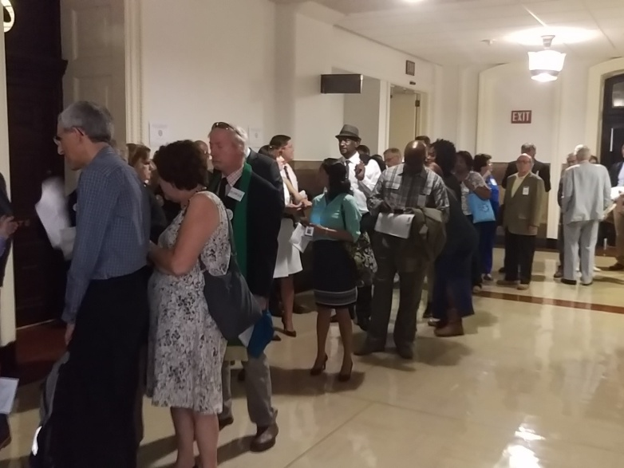
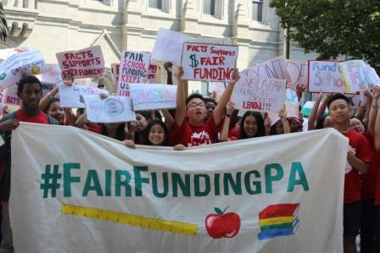
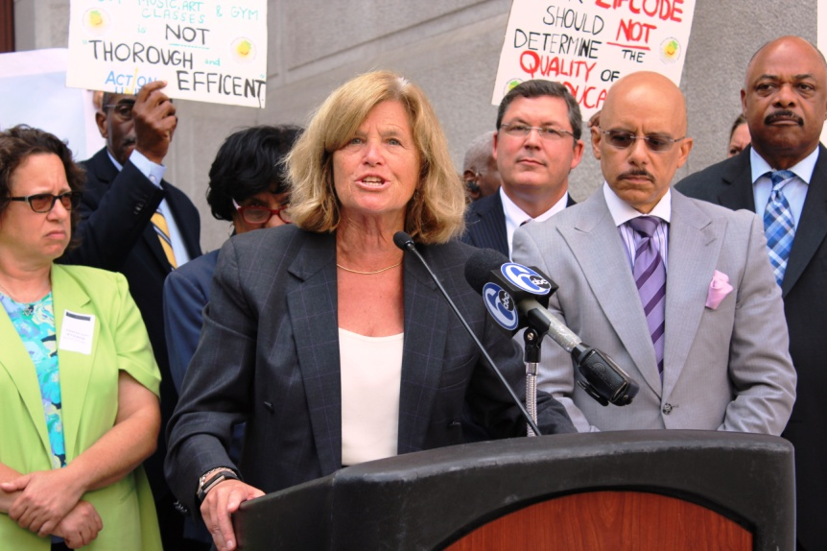
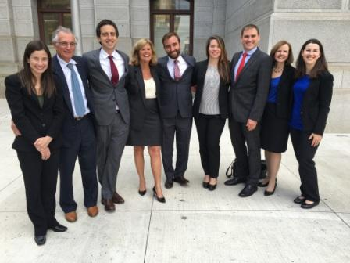
September 2016: Oral argument

Slide 51
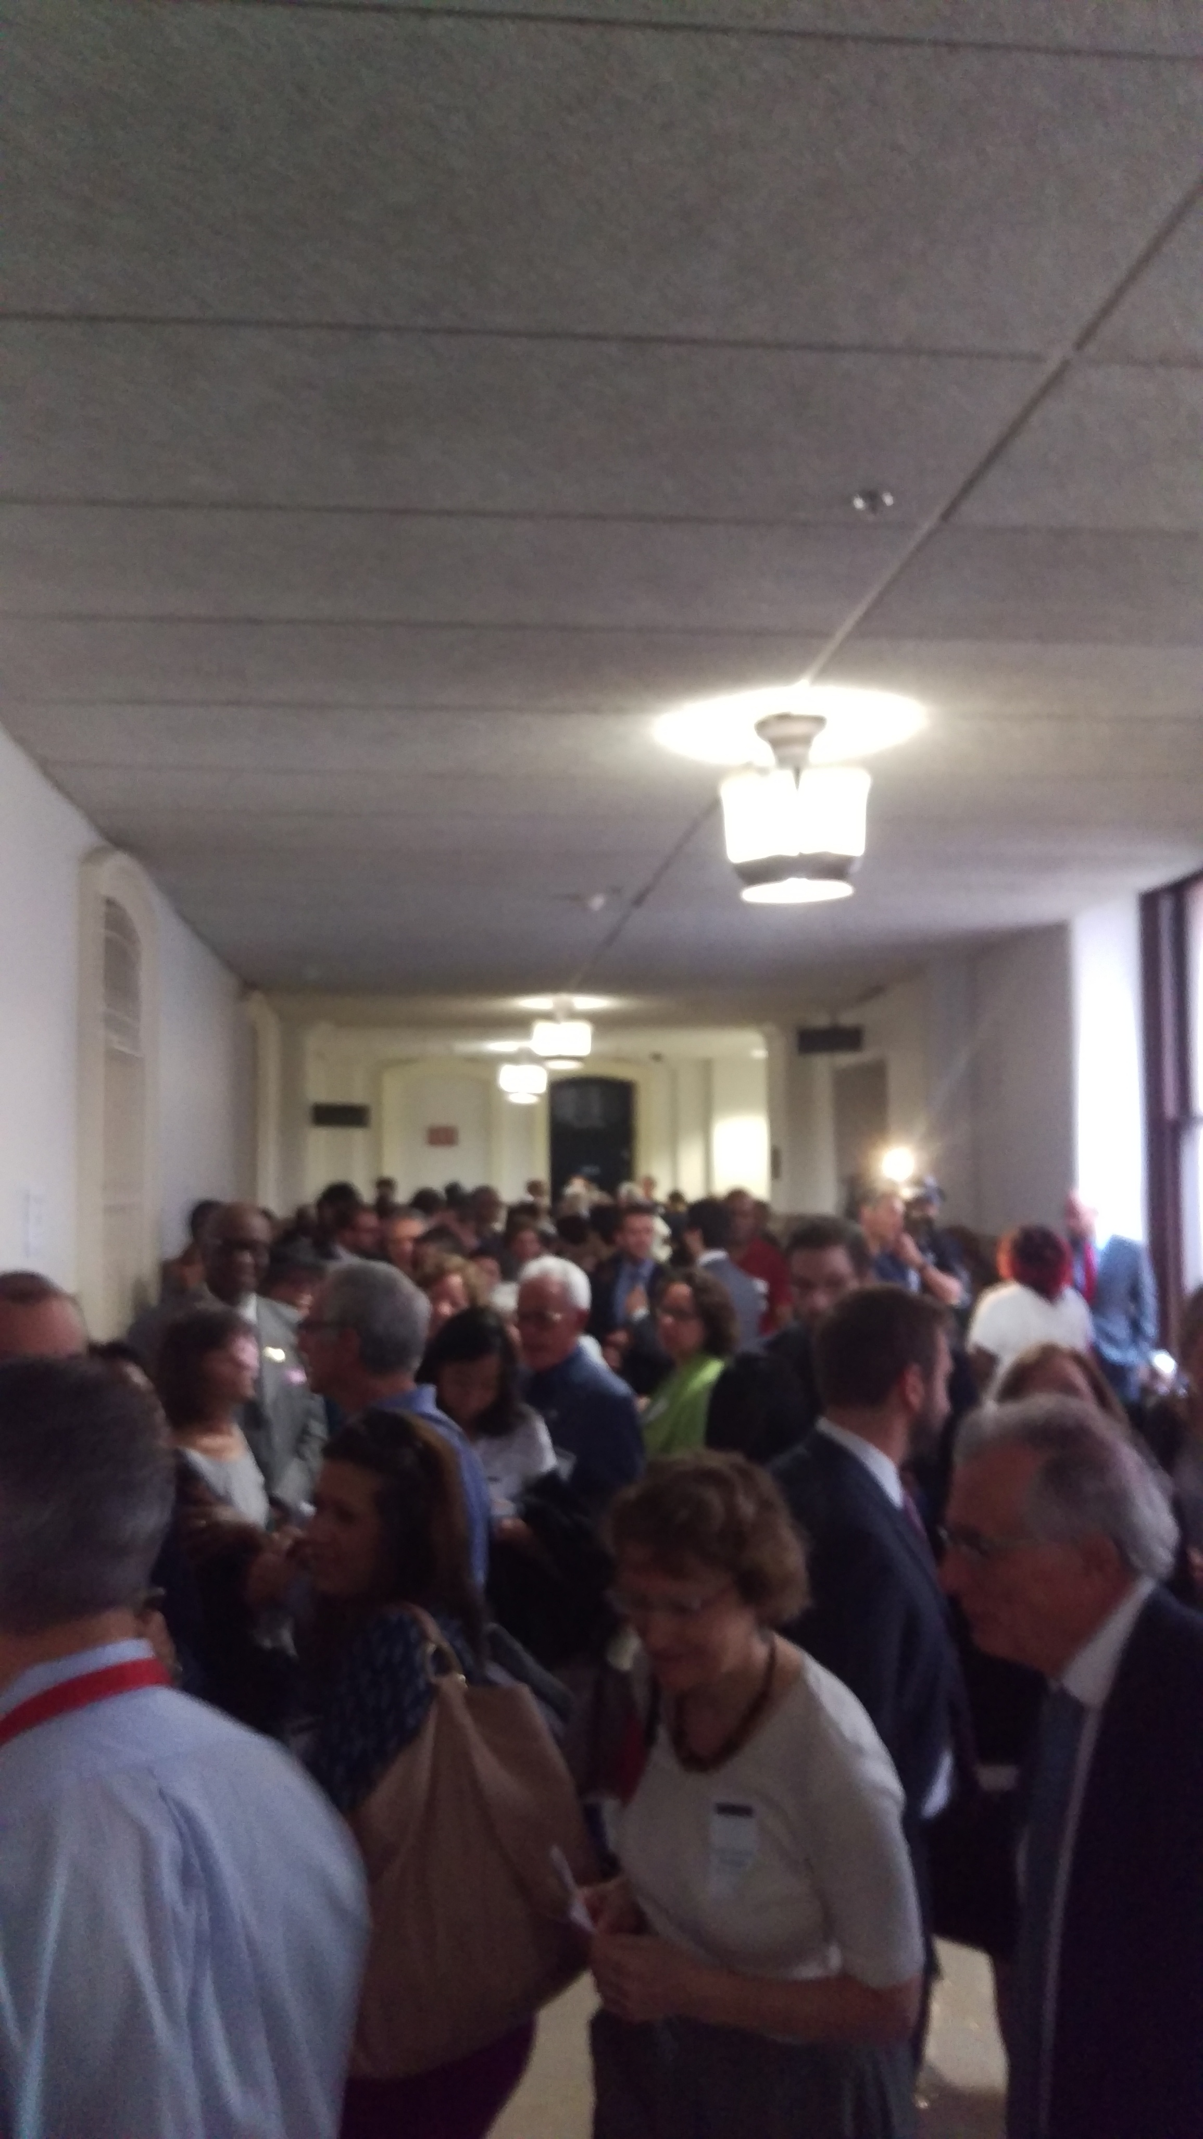
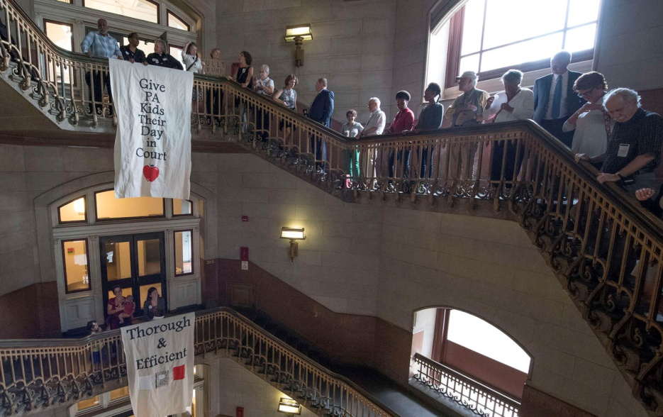
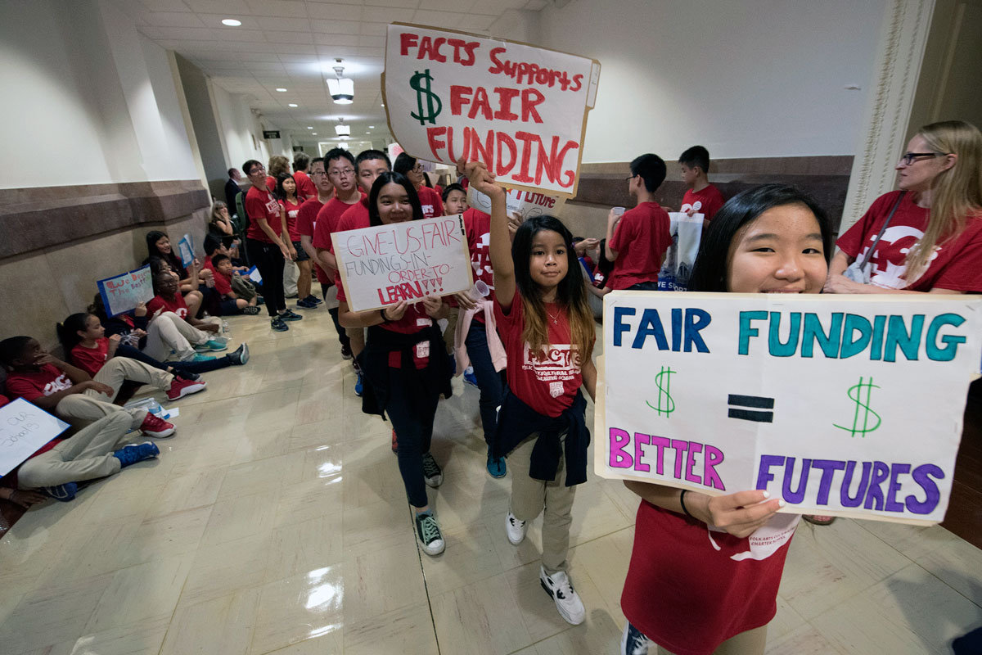
September 2016: Oral argument

Slide 52
William Penn SD et al., v. PDE et al.: Legal Arguments by the Governor and Legislators
Similar cases decided in 1999; Supreme Court ruled there were not manageable standards.
Process for securing a remedy is messy and time-consuming.
The only obligation the legislature has is to “turn the lights on;” they are meeting that obligation.
No child has an enforceable right to a sound education

Slide 53
William Penn SD et al., v. PDE et al.: Legal Arguments by the Families and School Districts
Today there are measurable standards:
Legislature has prescribed what children should learn
Legislature has established standardized tests to measure learning.
Legislature is capable of determining how much it costs for children to learn content as shown in the 2007 Costing Out study
No Court in any state has ever held that education equal protection claims are not justiciable.
The Court is the only body that is legally obligated to protects children’s constitutional rights.

Slide 54
Has this been done before?
YES!
There have been successful constitutional lawsuits in 29 other states.
Seven other states have the same exact clause.
All seven times it has been found to be justiciable

Slide 55
What’s the Matter with Kansas Pennsylvania?
Gannon v. State of Kansas, No. 112,267 (Mar. 2, 2017):
Claim under the Kansas Constitution’s education clause is justiciable; judicially manageable standards exist for such a claim, because of state standards that look a lot like Pennsylvania’s
Using test scores (which look better than Pennsylvania’s) and other evidence, the Court found the funding system constitutionally inadequate
The Court specifically noted the effects on Hispanic and African-American students
It ordered the Kansas Legislature and Government to fix it

Slide 56
Will this help?
YES!
Studies show that funding lawsuits:
Bring about more revenue than a state would otherwise have raised
Increase academic achievement
It would break political impasse over funding by invoking independent process based on cost analysis

Slide 57
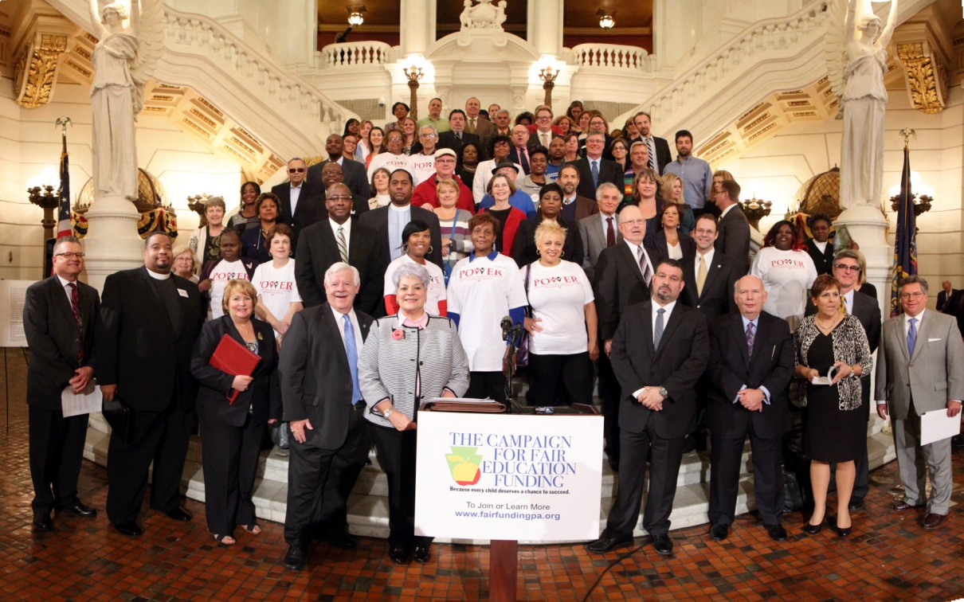
The Campaign for Fair Education Funding
*Adequacy *Equity *Predictability *Accountability
www.fairfundingpa.org
@FairFundingPA

Slide 58
Resources
Our Website
http://www.pubintlaw.org/school-funding-lawsuit
Lawsuit Website
https://edfundinglawsuit.wordpress.com
Public Citizens for Children + Youth: http://www.pccy.org/

